Slide 1
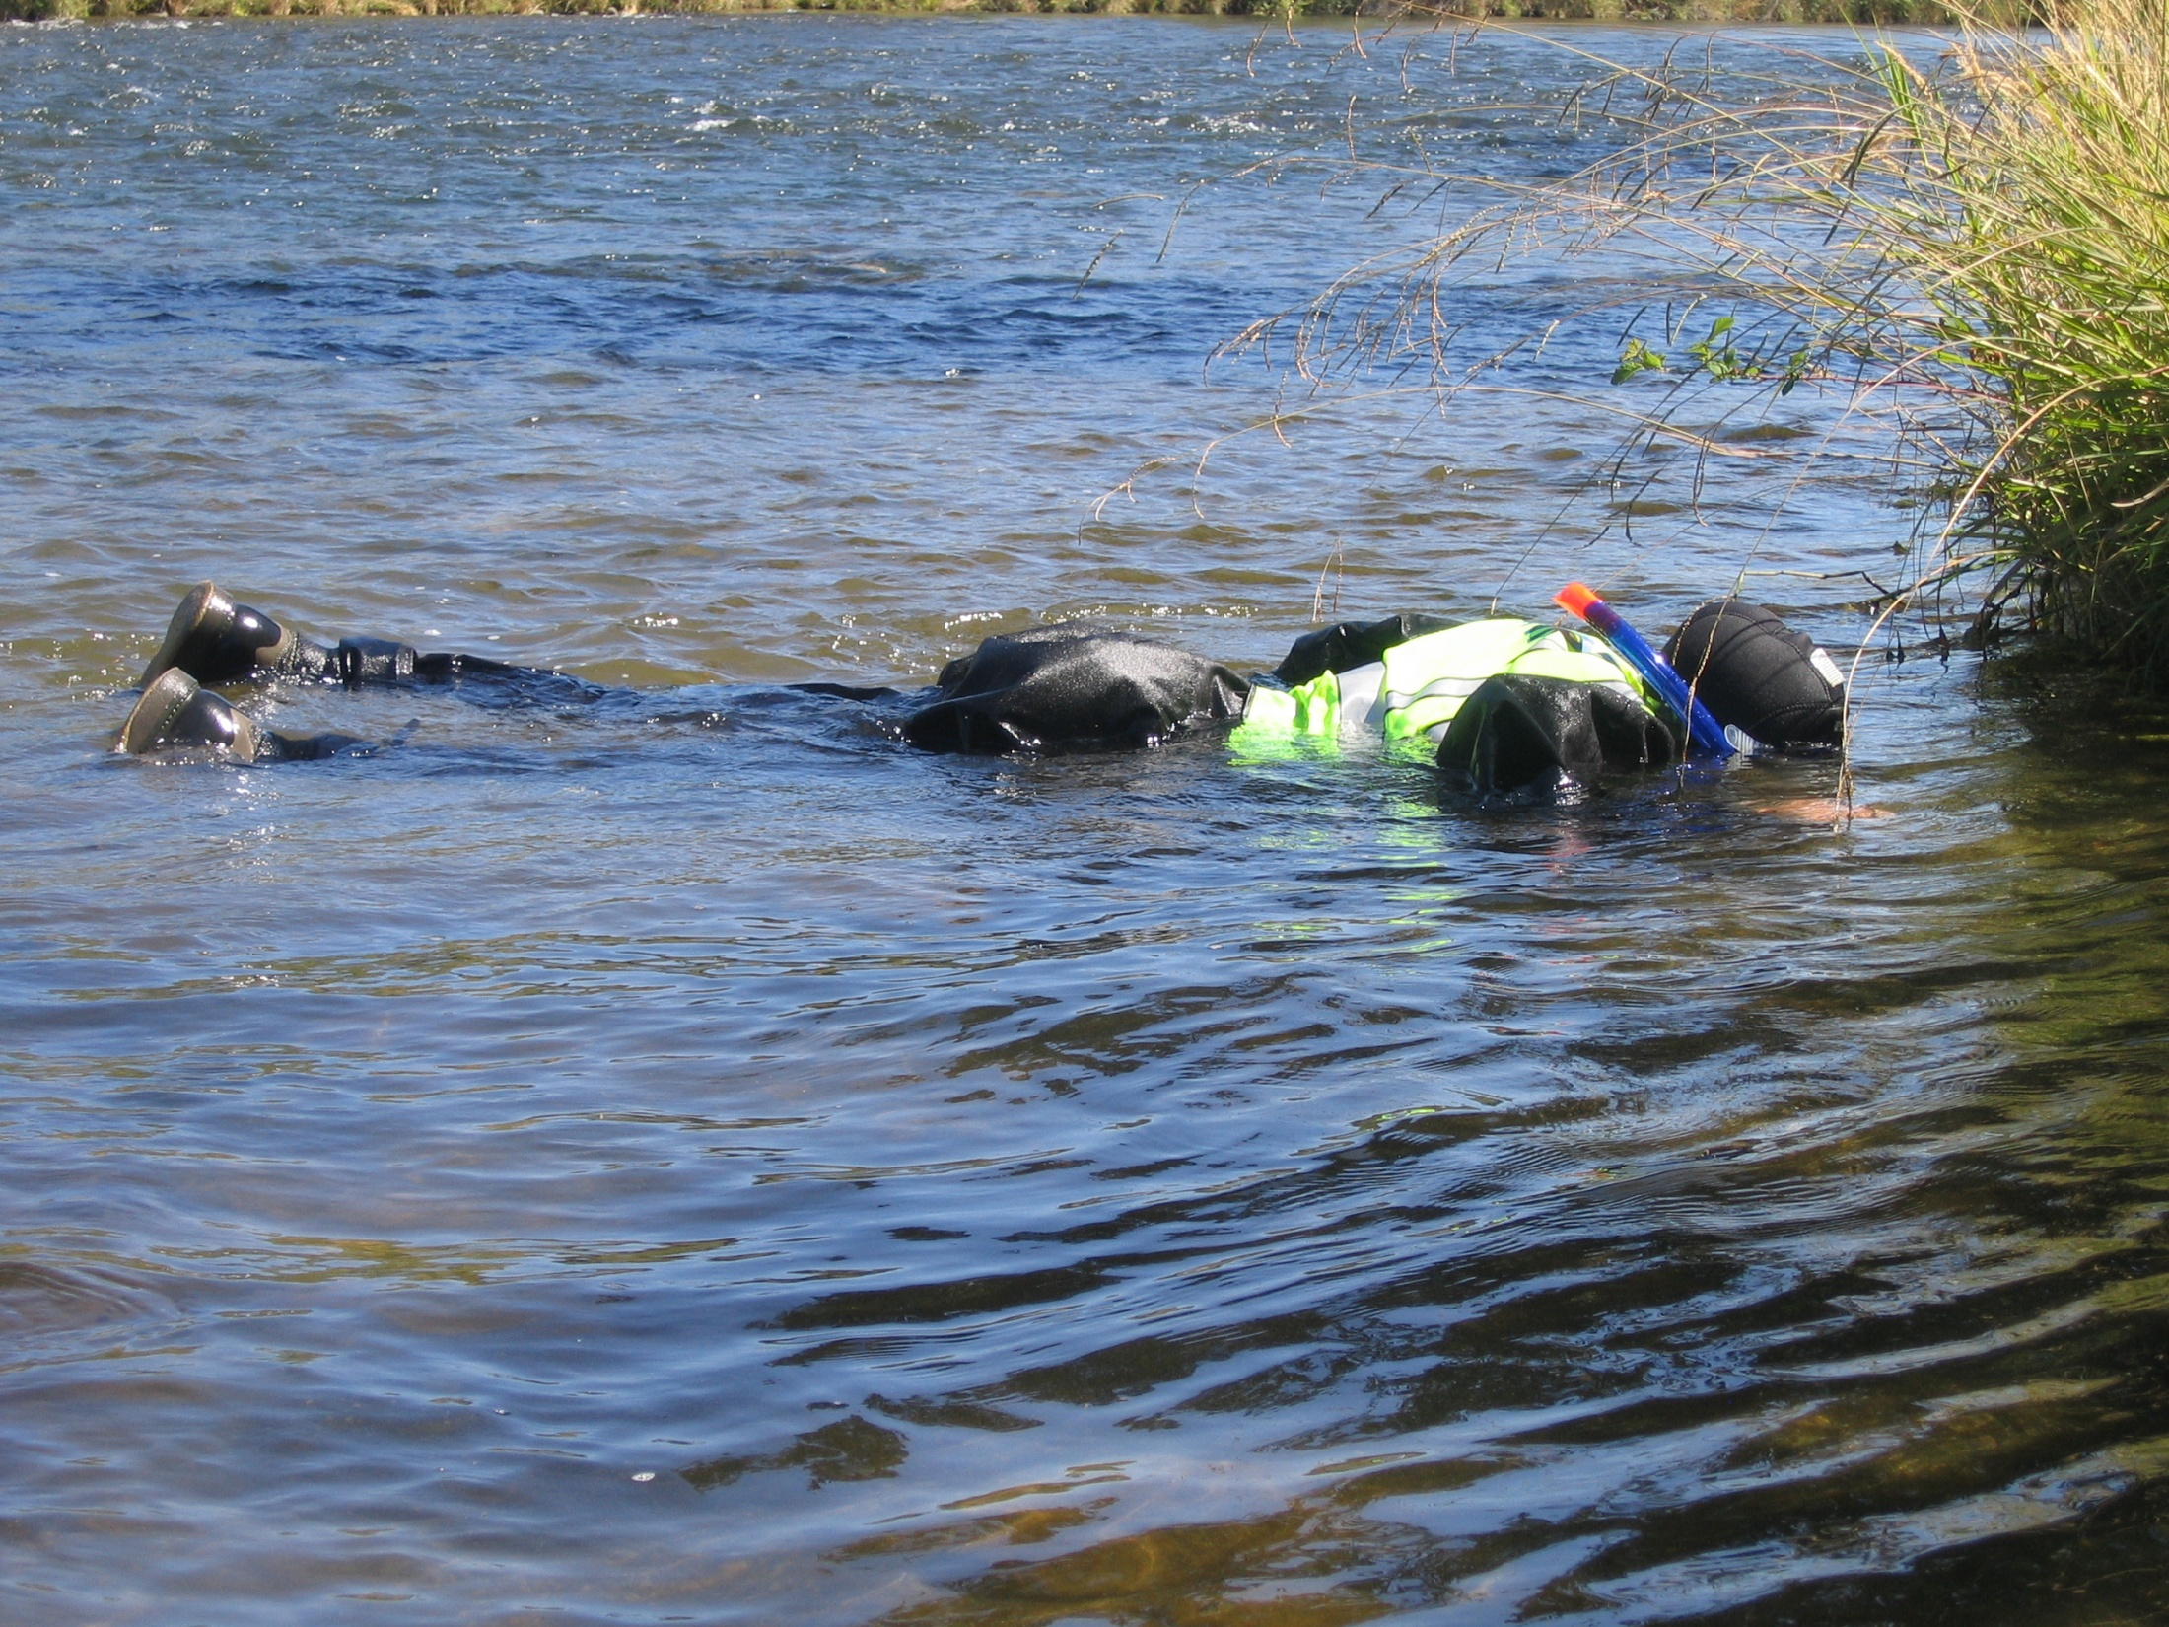
Snorkel
Maps

Slide 2
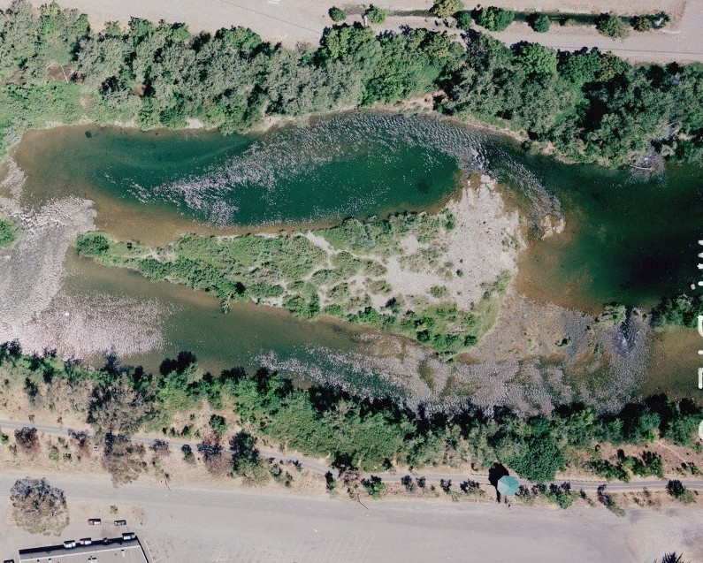
23
24
25
19
Boat
Hatchery Riffle
Notes:
Hatchery

Slide 3
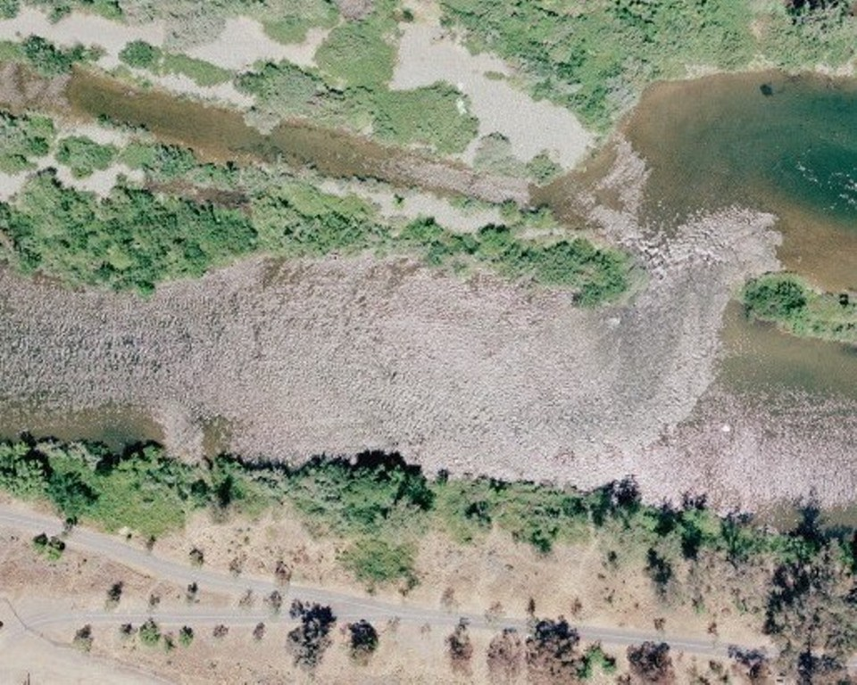
29
Boat
31
30
32
Auditorium Riffle
Notes:
Auditorium

Slide 4
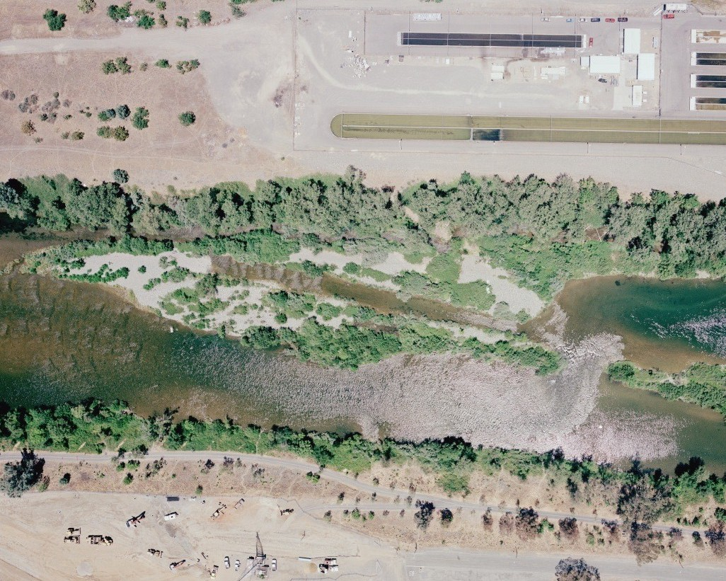
33
26
Boat
28
Hatchery Ditch
Notes:
Hatchery Ditch and Moe’s

Slide 5
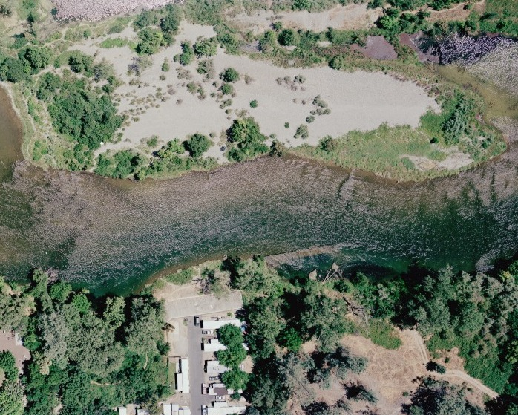
98
Boat
97
96
Trailer Park Riffle
Notes:
Trailer Park

Slide 6
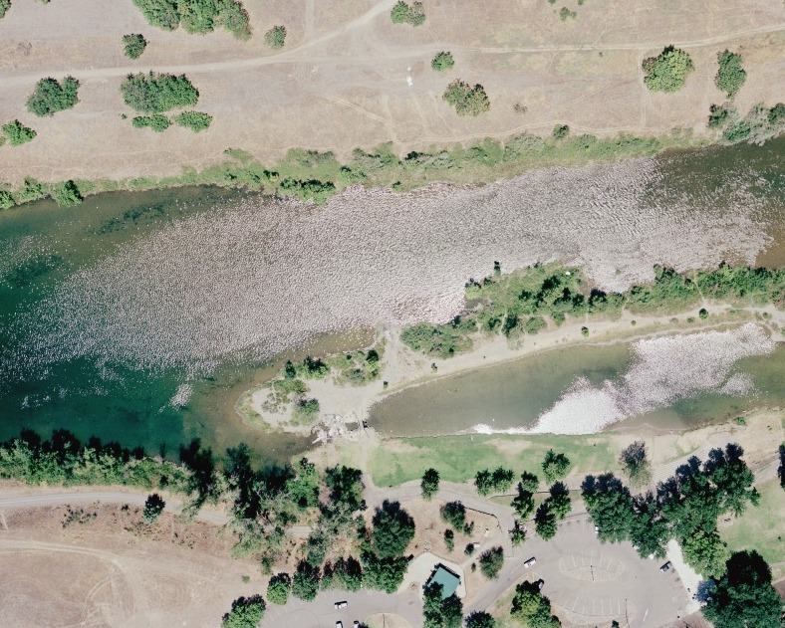
55
Boat
56
Bedrock Riffle (River Left)
Notes:
Bedrock

Slide 7
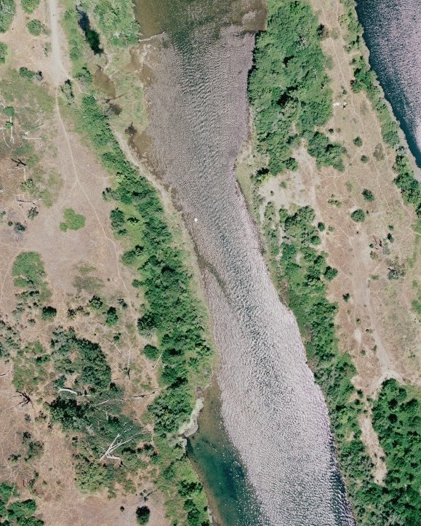
Boat
105
104
103
Mathews Riffle
Notes:
Mathews

Slide 8
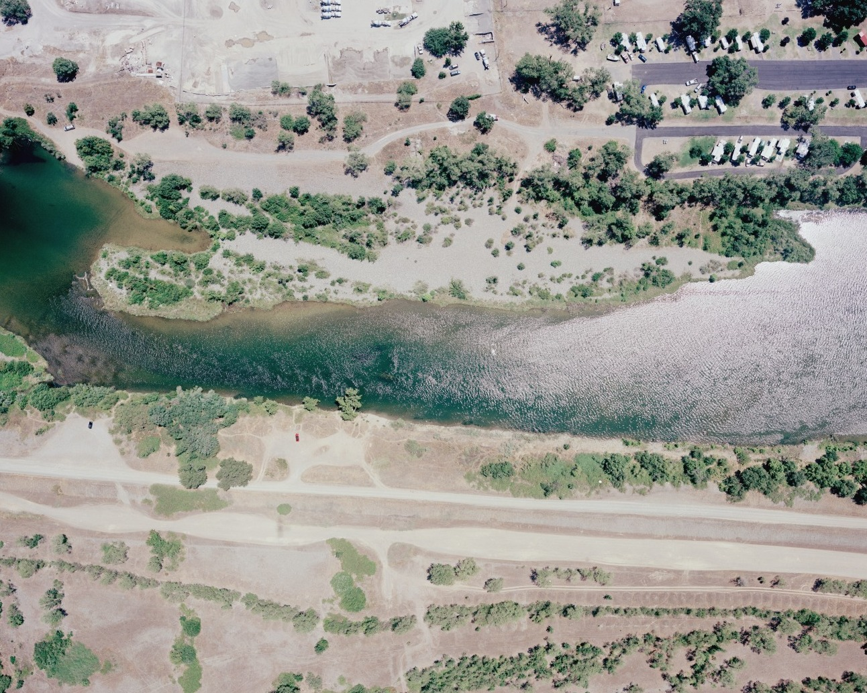
Boat
120
119
Aleck Riffle (River Right)
Notes:
Aleck Riffle

Slide 9
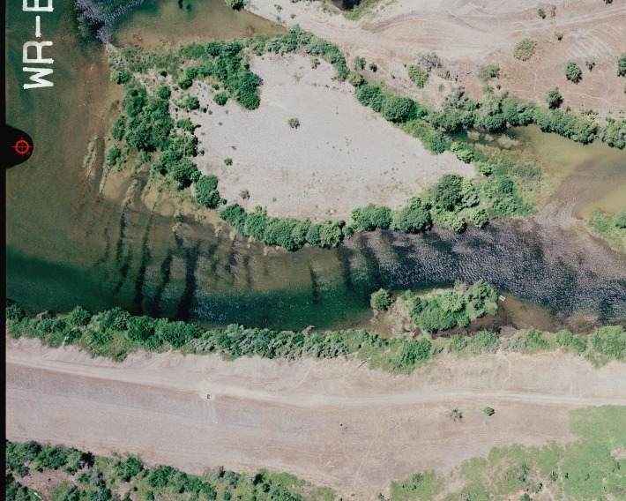
171
175
Boat (end)
170
174
Boat (start)
173
169
Robinson Riffle
Notes:
Robinson

Slide 10
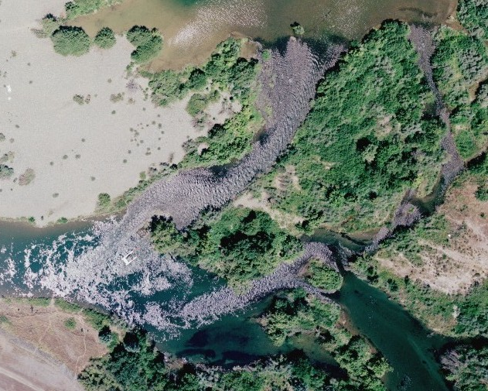
Boat (end)
185
Boat (start)
189
Steep Riffle
Notes:
Steep

Slide 11
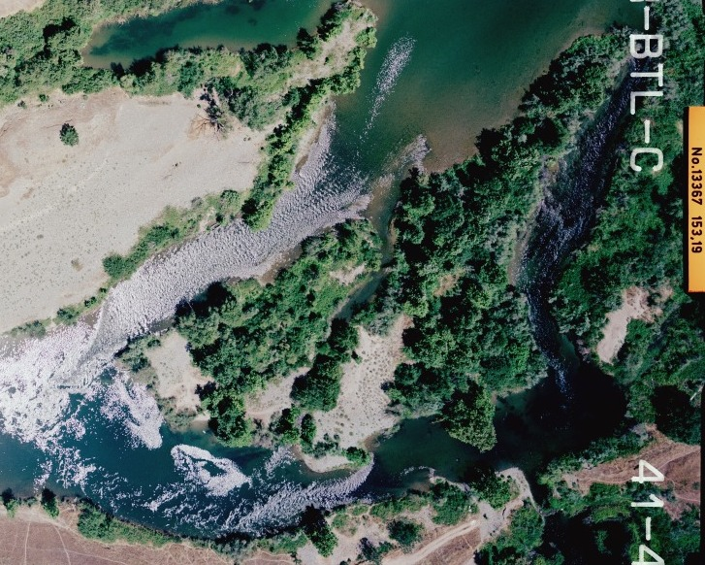
Eye Riffle
215A
210
217
216
215B
Notes:
Eye

Slide 12
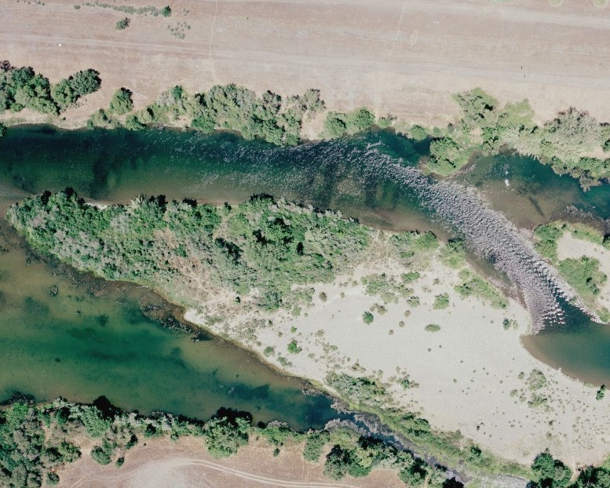
Boat (end)
228
229
226
221
225
Boat (start)
Gateway Riffle
Notes:
Gateway

Slide 13
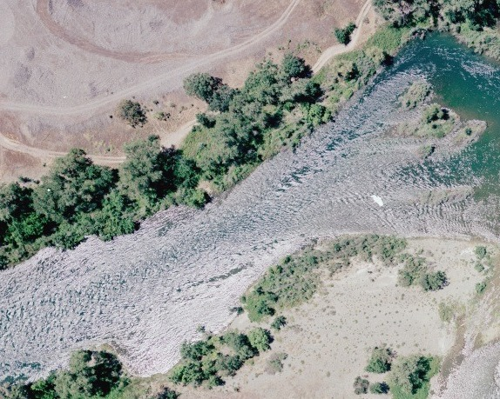
266
Boat (drop-off)
268
Boat
Vance West Riffle

Slide 14
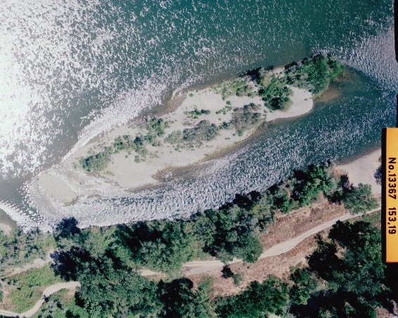
Boat
323B
323A
G95 Side
Notes:
G95 Side

Slide 15
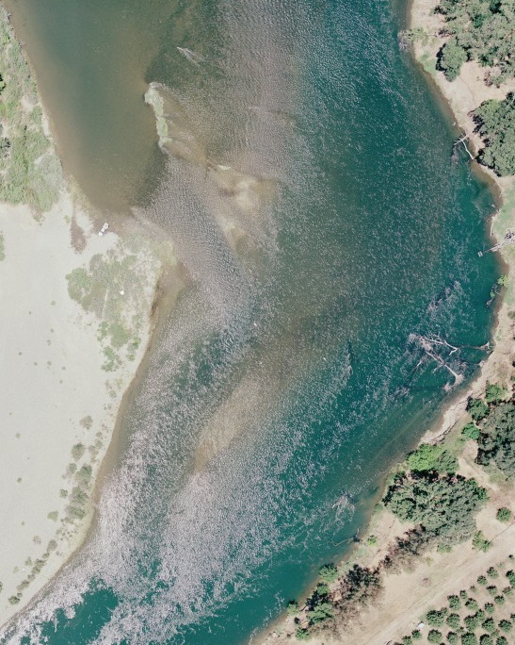
403
Boat
397
402
Kiester Riffle
Notes:
Kiester

Slide 16
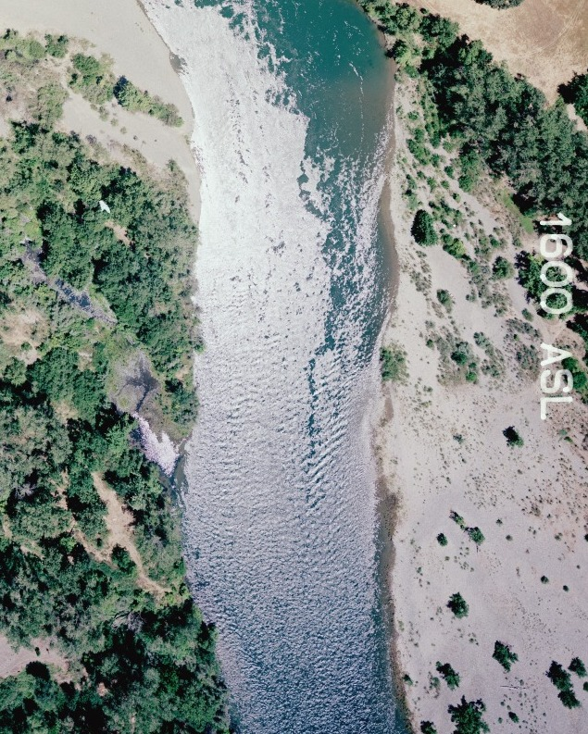
408
Boat
Goose Riffle
Notes:
Goose

Slide 17
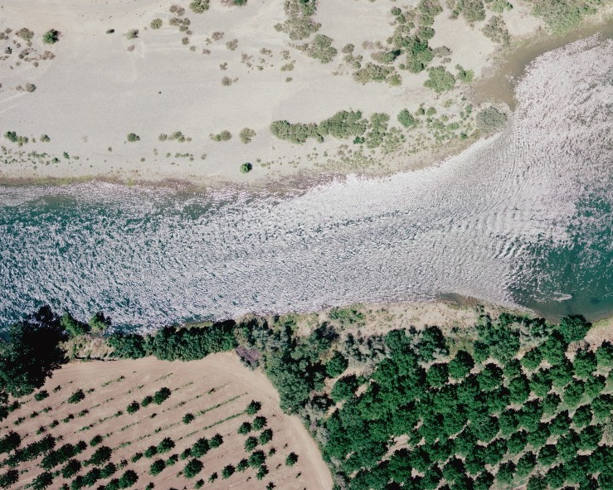
424
426
Boat
Big Riffle
Notes:
Big

Slide 18
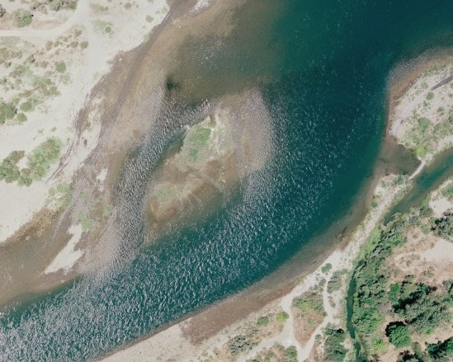
Boat
441
445
Boat (drop-off)
Upper McFarland
Notes:
McFarland Upper

Slide 19
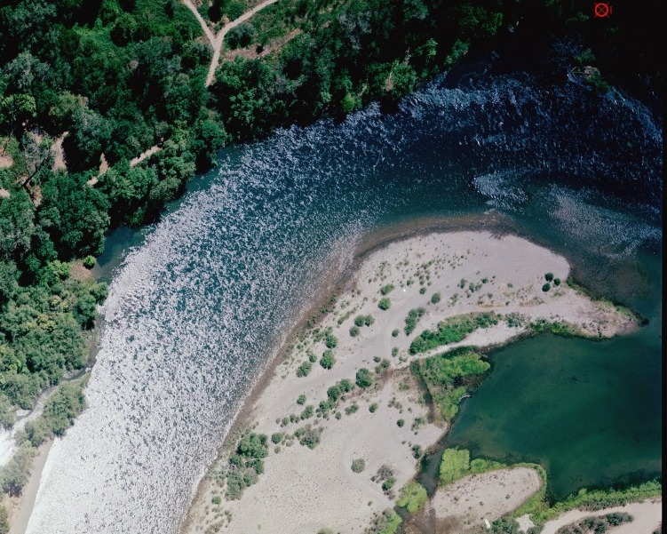
450
Boat
Boat (drop-off)
Lower McFarland
Notes:
McFarland Lower

Slide 20
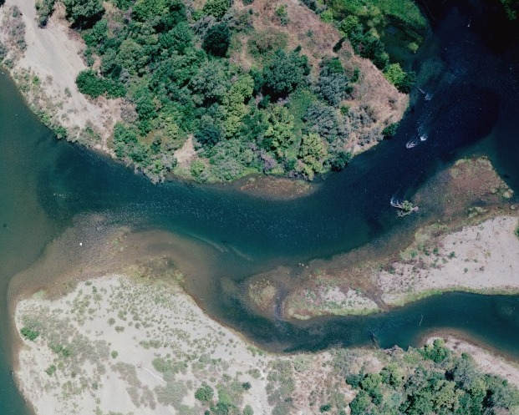
486
Boat
487
Gridley Riffle
Notes:
Gridley

Slide 21
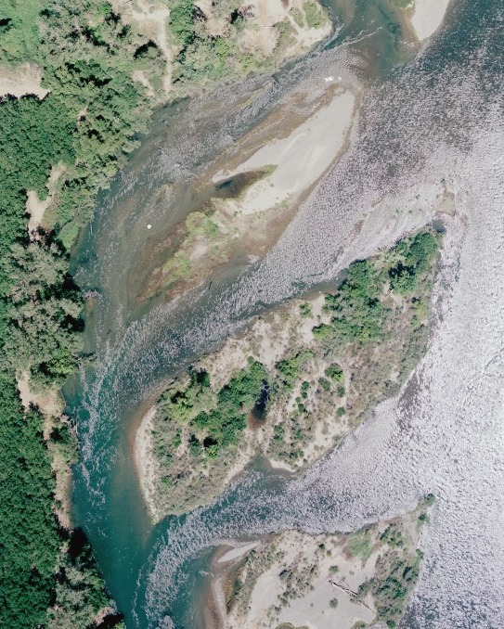
499
Boat
502
Junkyard Riffle
Notes:
Junkyard

